Slide 1
This project is one of the T5 Data Science BootCamp Nadia hjrasi

Slide 2

Individual Company customer Data

Slide 3
Introduction of project
Customer data analysis is a detailed analysis of a company's ideal customers. It helps businesses better understand their customers and makes it easier for them to modify products according to the specific needs, behaviors, and interests of different types of customers.

Slide 4
The dataset is provided in .csv ,and dataset includes about 40,000 rows and 15 columns

Slide 5
Steps of the project as follows: 1-Load Dataset 2-Explore Dataset 3-Cleaning Dataset 4-Analysis and Visualization

Slide 6
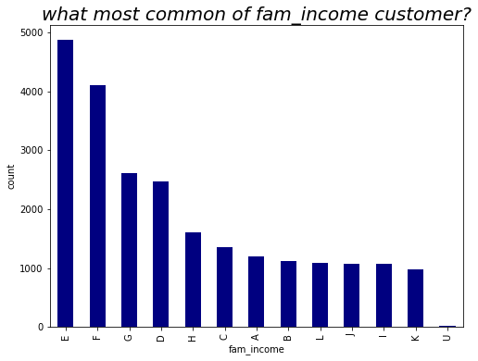
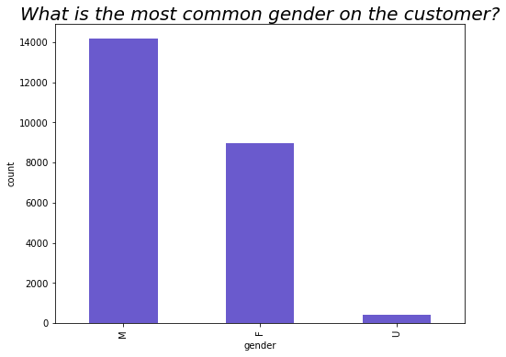
summary of analysis and Visualization

Slide 7
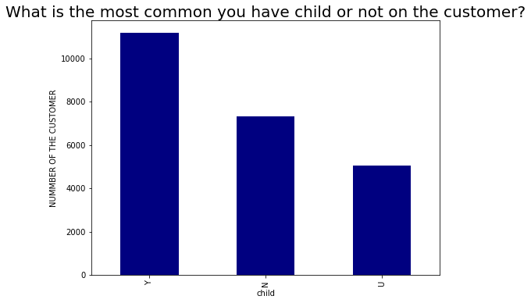
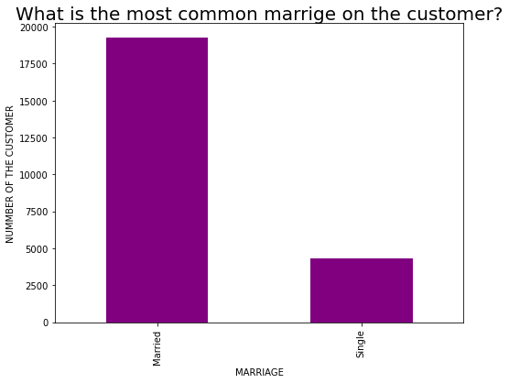

Slide 8
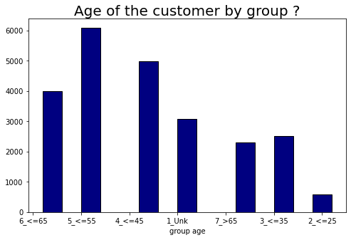
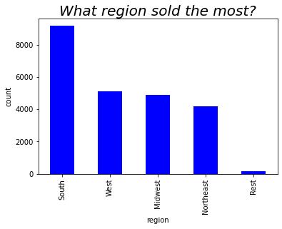

Slide 9
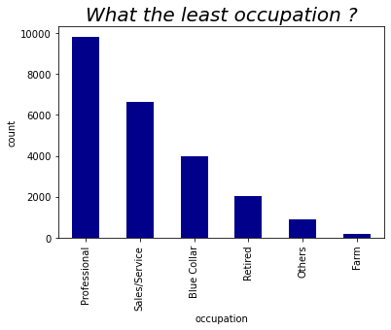
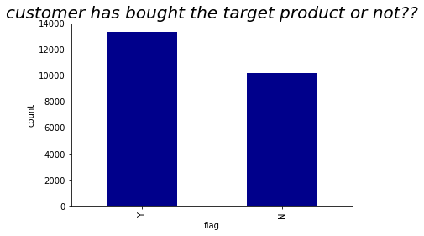

Slide 10
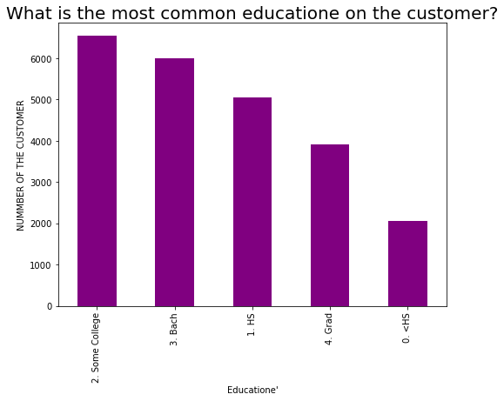
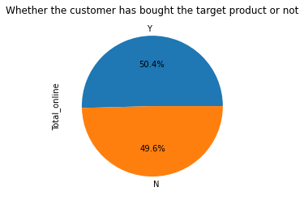

Slide 11
Conclusion
Data analytics helps transform all business processes. This includes being able to match customer expectations, changing the company's product line and of course ensuring that marketing campaigns are robust. It helps in solving problems, increasing the company's production, identifying the target groups, and through which appropriate decisions can be taken about improving quality or products

